Slide 1

Body Sensor Network Lab Project Presentation
Beike Lu, Daoping Wang
Supervisor: Swaminathan Narayanaswamy
Chair of Realtime-Computersystem
Munich, 08.02.18
Notes:
We are group 2. I am very glad to see you coming to our final presentation. I will first go through the outline of today‘s presentation. And after the presentation I am going to show you the application we developed through this semester.

Slide 2
Outline
Concept design in Matlab - Data analysis - Model design
Model building in Tensorflow - Neural Network classifier
Recognized activities
Android-App development - Backend: Matlab functions re-implemented, manually - Integration of the Tensorflow-model - Graphical User Interface (GUI)
Additional Features - Step counting - State stabilisation
Conclusion - Pros and Cons of our approach - Future work - Project schedule
Notes:
First, I will introduce the basic concept of our approach, which is designed in Matlab. Then we come to the actual classifier model for activity recognization, which is in our case a Neural Network classifier implemented and trained in Tensorflow.
Then, we will explain the activities that are recognized by our model, the development of the Android application, the additional features we accomplished. And finally, we are going to sum up the whole content and give a short evaluation.

Slide 3
Concept design in Matlab – Data analysis
Mission: motion recognization based on sequences of triaxial acceleration data
Idea: Extract feature values from data sequence and predict motion status
Approach: train a classification model using labeled data
x
Feature extraction
Classification
model
y
Feature Vector
Motion prediction
z
Notes:
The ultimate objective of this project is to recognize activity based on triaxial acceleration data sequence collected by a sensor. So the first step would be analysing these data and to find a way to do classification based on the difference between data that are representing different activities.
In our approach, we consider extracting feature values from these data sequences and predict the activity based on these feature values. To do this, we consider training a classification model using the collected data. This model could be either a decision tree, or a kNN classifier or something similar.
This picture shows the data flow in our concept model. We have xyz acceleration values as input for the first block, which does the feature extraction. The extracted feature values are then concatenated into a vector and fed into the classifier, whose output is the final prediction.

Slide 4
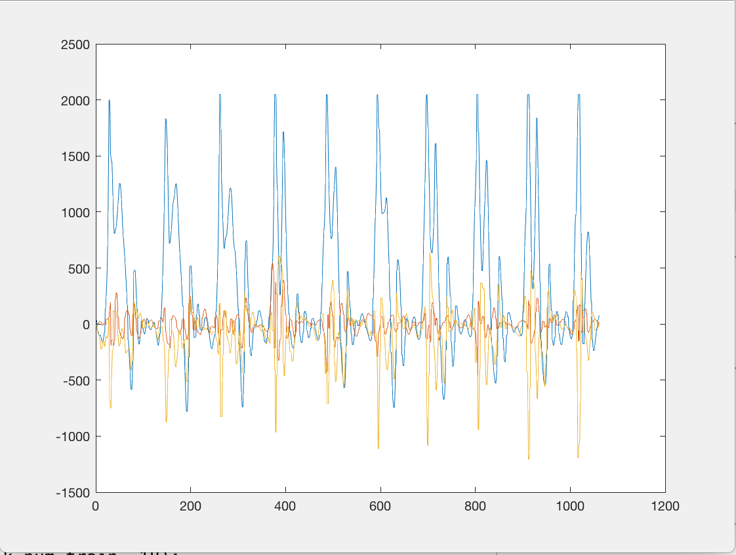
Concept design in Matlab – Data analysis
Step 1: Collect enough training data
Notes:
Lets talk about data analysis. The first step is to collect as much data as possible, since we need them to train a complex model later.

Slide 5
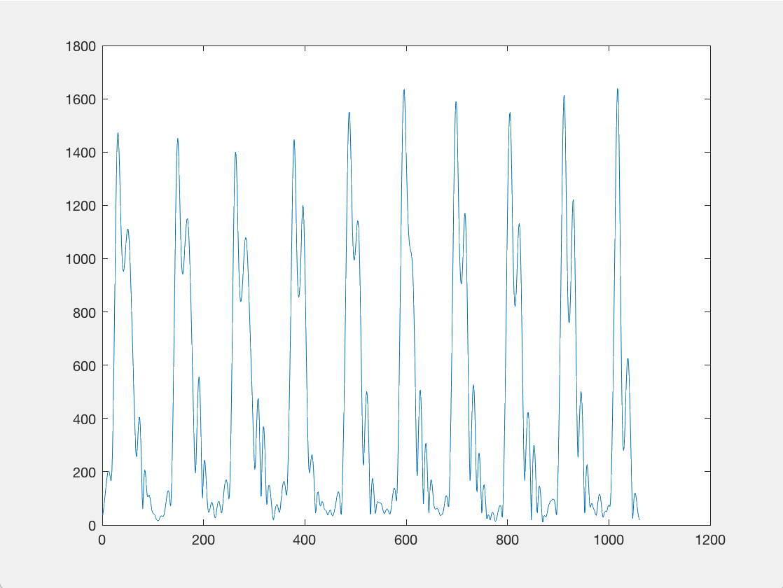
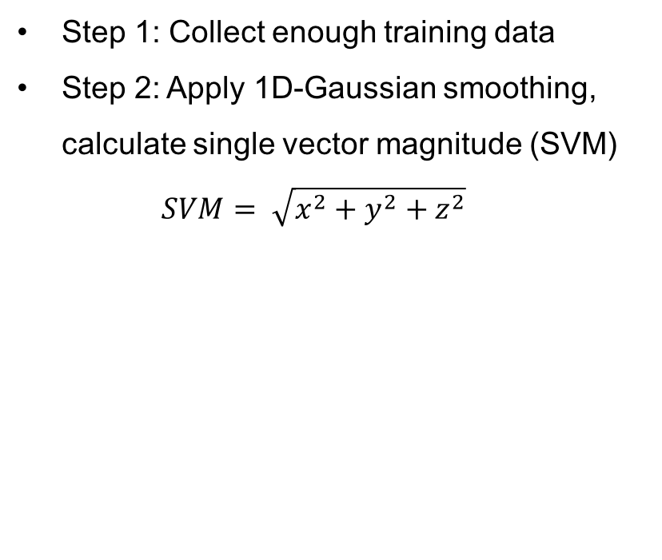
Concept design in Matlab – Data analysis
Step 1: Collect enough training data
Step 2: Apply 1D-Gaussian smoothing, calculate single vector magnitude (SVM) $SVM= \sqrt{x^{2}+y^{2}+z^{2}}$
Notes:
To reduce noise in the data, a 1D Gaussian filter is applied on the triaxial data, where the sigma of the Gaussian function defines the level of smoothing.
Then, we consider combining the triaxial data into a 1D curve that represents the overall acceleration. The reason for doing this is that we want to obtain the maximum amount of information from the data, and by concatenating the data, we are essentially gaining information. This 1D signal is called Single Vector Magnitude, abbreviated as SVM.

Slide 6
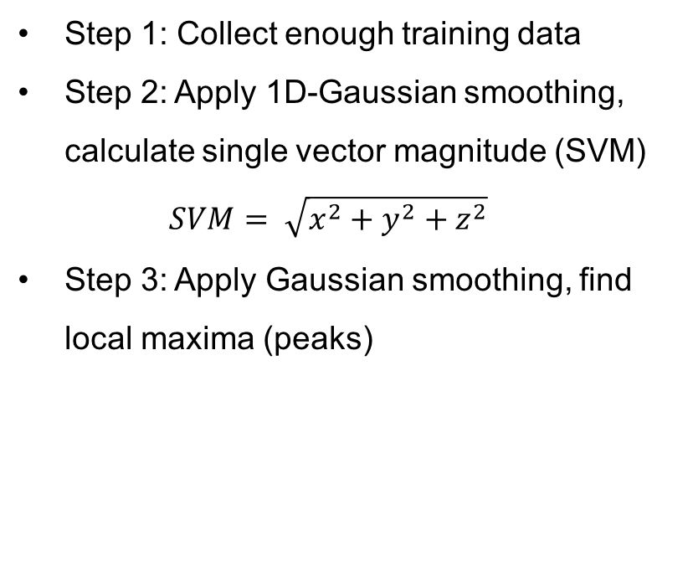
Concept design in Matlab – Data analysis
Step 1: Collect enough training data
Step 2: Apply 1D-Gaussian smoothing, calculate single vector magnitude (SVM) $SVM= \sqrt{x^{2}+y^{2}+z^{2}}$
Step 3: Apply Gaussian smoothing, find local maxima (peaks)
Notes:
In the third step, we apply Gaussian smoothing on the SVM, and we find local maxima, which are the peaks of the data. These peaks are considered as a feature.

Slide 7
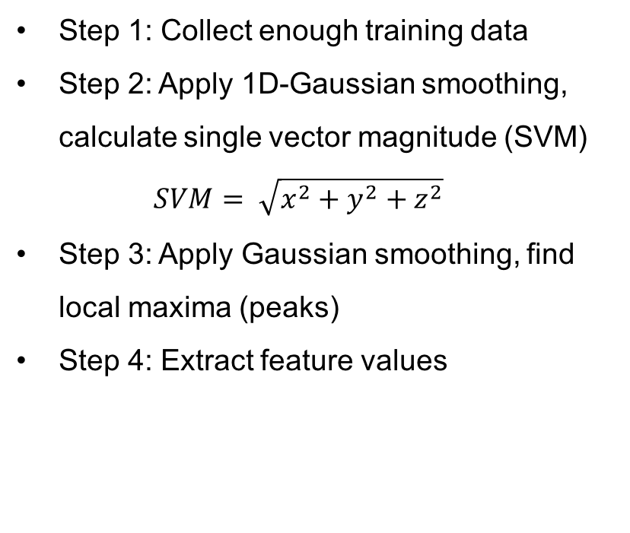
Concept design in Matlab – Data analysis
Step 1: Collect enough training data
Step 2: Apply 1D-Gaussian smoothing, calculate single vector magnitude (SVM) $SVM= \sqrt{x^{2}+y^{2}+z^{2}}$
Step 3: Apply Gaussian smoothing, find local maxima (peaks)
Step 4: Extract feature values
mean(SVM) | 451.702809
mean(x) | 334.6011986
mean(y) | 1.479196048
mean(z) | -88.33209837
max(SVM) | 1443.532031
max(x) | 1571.479894
max(y) | 264.4306325
max(z) | 415.8009428
min(SVM) | 23.47689762
min(x) | -467.3235691
min(y) | -172.2181659
min(z) | -618.6605361
std(SVM) | 422.1894499
std(x) | 525.8459514
std(y) | 51.88509981
std(z) | 137.2740349
mean(Peaks) | 1313.458669
Notes:
At last, we extract the actual features from the parsed data. As you can see here, we use 17 features in total to represent a sequence of data.

Slide 8
Concept design in Matlab – Data analysis
Feature vector represents the corresponding time series of motion data
The length of the time series can be arbitrary
Our approach: 1. Split training data into short sequences 2. Evaluate feature vectors 3. Train the model
mean(SVM) | 451.702809
mean(x) | 334.6011986
mean(y) | 1.479196048
mean(z) | -88.33209837
max(SVM) | 1443.532031
max(x) | 1571.479894
max(y) | 264.4306325
max(z) | 415.8009428
min(SVM) | 23.47689762
min(x) | -467.3235691
min(y) | -172.2181659
min(z) | -618.6605361
std(SVM) | 422.1894499
std(x) | 525.8459514
std(y) | 51.88509981
std(z) | 137.2740349
mean(Peaks) | 1313.458669
Notes:
One adventage of doing this feature extraction is that the length of the data sequence can be arbitrary. It does not matter whether the data sequence you want to classify consists of 64 data points, which correspond to roughly 0.4 seconds, or 640 data points corresponding to 4 seconds, the two feature vectors should be quite similar if the two data sequences are of the same activity.
To sum up the basic concept, we first split the complete data into short sequences, then, we evaluate feature vectors and use them to train the model.

Slide 9

Concept design in Matlab – Model design
Former plan: - Train a decision tree using MATLAB Statistics and Machine Learning Toolbox
Problem: - Good prediction results , but - Loading the trained tree into generated C code: not possible
Plan B: - Train a Neural network using Tensorflow (in Python) (An open-source machine learning framework from Google)
Notes:
Then we come to the model building part. Our former plan was to implement the algorithm, the model, in Matlab. Matlab has a built-in Statistics and Machine Learning Toolbox which provides a lot of ready to use functions, so we thought that using the Toolbox would be the most straight forward approach and would spare us time.
Therefore, we trained a decition tree with the collected data and the toolbox and tried to convert the Matlab code into C code, which could be wrapped with the Android project using the JNI interface. However, it turns out that the trained model, in our case a decision tree, cannot be loaded by the C code generated by Matlab Coder. The model is saved as a special Matlab variable in a .mat file, and this variable type is not supported by the generated C code. So we have to come up with other ideas.
The plan B, which we chose to implement, is to train a Neural Network classifier using Tensorflow. Tensorflow is an open-source machine learning framework from Google and is officially supported by Android, meaning that one can build and train the model on PC and load the trained model on the mobile phone using the official interface. Since Tensorflow is formerlly designed for Python, we have implemented the model in Python.

Slide 10
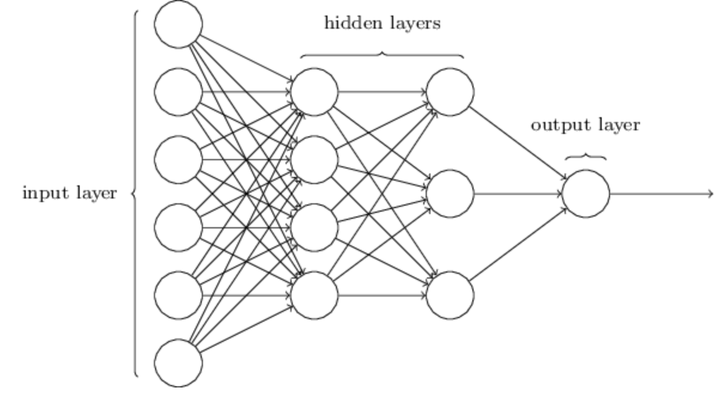
Model building in Tensorflow – Neural Network Classifier
Input layer: 17 neurons (as we have 17 features as input)
Output layer: 4 neurons (4 possible motion states)
Hidden layers: bunch of neurons (to compensate high non-linearity)
Training phase: 1. Using feature vectors of training data as input 2. Let the NN predict motion 3. Optimize the NN using gradient descent
Notes:
Our Neural Network takes the extracted 17 feature values as input, so its input layer has 17 neurons. Its output layer consists of 4 neurons, which are responsible for outputting the prediction. Since we were planning to recognize 4 types of activities, the output layer has 4 neurons. If for example the first activity is recognized, the first neuron would put out a 1, while the rest of the neurons puts out zeros.
The center part of the Neural Network consists of 4 hidden layers with around 50 neurons in each layer. The reason for this setup is that the relation between the 17 features and the 4 activities is highly non-linear, so we have to compensate this non-linearity by training a complex Neural Network.
In the training phase, we use the collected data as input; we let the model predict the activity and tells it whether the prediction was correct or not. The neurons of the model will be trained using gradient descent, which is basically propagating the error backwards the Neural Network and change the weights and biases of them.

Slide 11
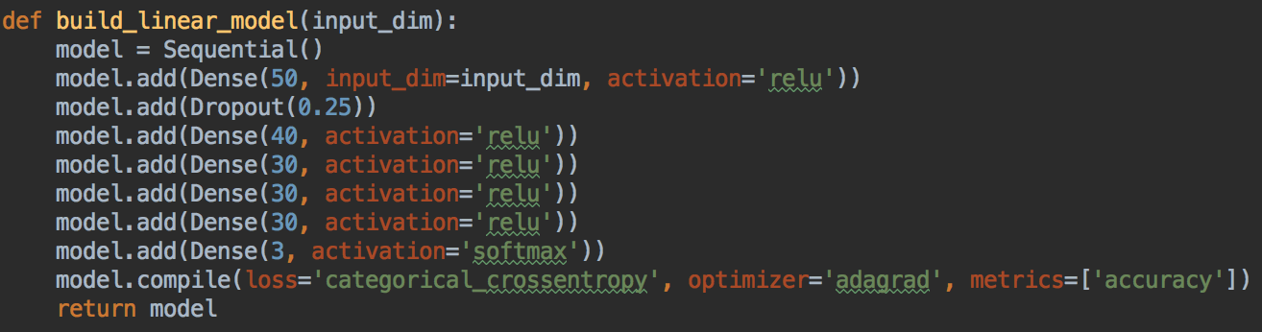
Model building in Tensorflow - Neural Network Classifier
Our model: - 5 hidden layers, each layer consists of ~40 neurons - Dropout rate of 25% between the first two layers (to avoid overfitting problem) - 260 training feature vectors - Results: 99.6% prediction accuracy on training data, ~80% accuracy on testing data
Notes:
So let us have a closer look on the model. We have 5 hidden layers, each of 40 neurons. To avoid overfitting problem, we cut off 25% of the connections between the first two hidden layers in each training iteration, which is formally called dropout.
We have 260 sets of training data in total, represented by the corresponding 17-dimensional feature vectors.
The training result was pretty good. Our neural network classifier reaches an accuracy of 99.6% on training data and around 80% on testing data.

Slide 12
Recognized activities
Walking - good recognization accuracy - Step counting possible
Running - the trained model sometimes misjudge jumping for running
Jumping - same as above
Idle
Notes:
The 4 activities that can be rocognized by the model are walking, running jumping and idle, which is not moving. The model has a very good prediction accuracy overall, and it can count steps. By the way, the model rarely makes the mistake of misjudging running or jumping. The reason for this could be that we do not have enough training data for jumping and running. so it is very hard for our model to draw a clear border between jumping and running. But as I said, this happens very rarely.
One more thing I want to explain is that our model cannot distinguish sitting from standing. The reason for this is that we consider the wearing posing of the sensor to be in front of the chest, and in this position, no difference in acceleration data can be found between sitting and standing. We did try out other wearing positions, like f.e. in the pocket. The model then became capable of detecting standing and sitting, very stabily, however, at the cost of prediction accuracy of other activities.

Slide 13
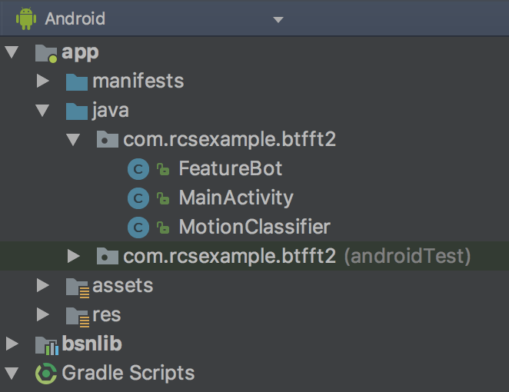
Android App development - Backend
Based on Example-App
Bluetooth connection part untouched
Reimplementation of MATLAB functions for feature extraction
Loading of the Tensorflow model

Slide 14
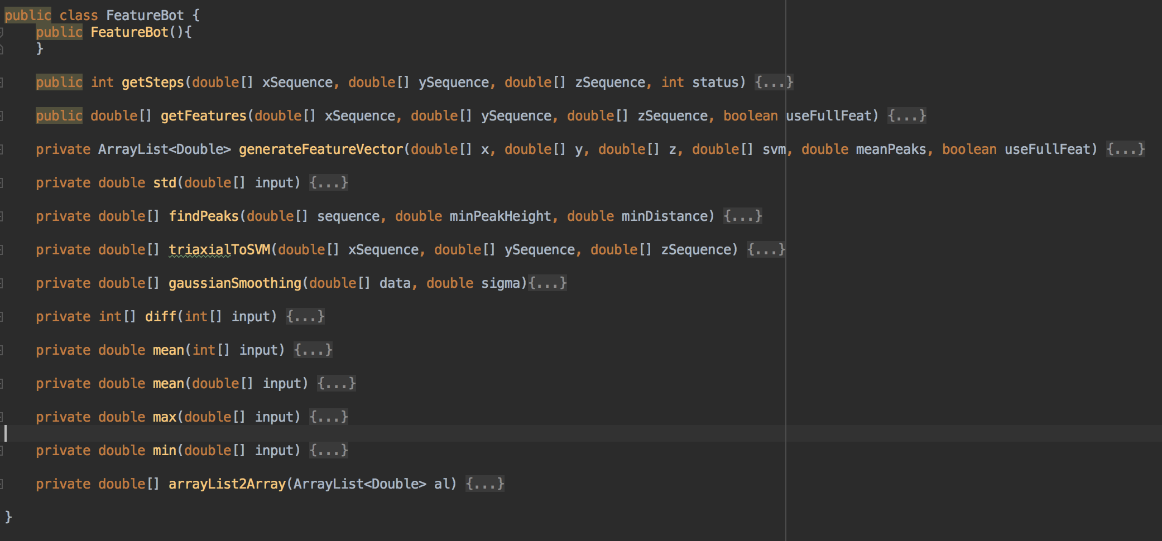
Android App development - Backend - class FeatureBot

Slide 15
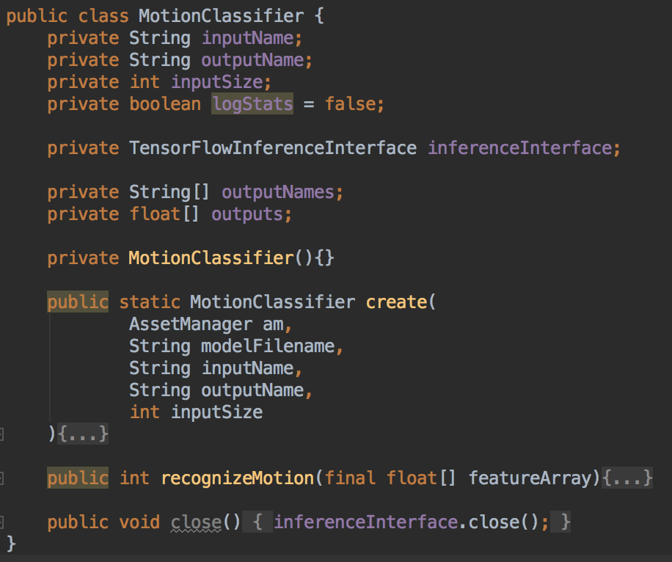
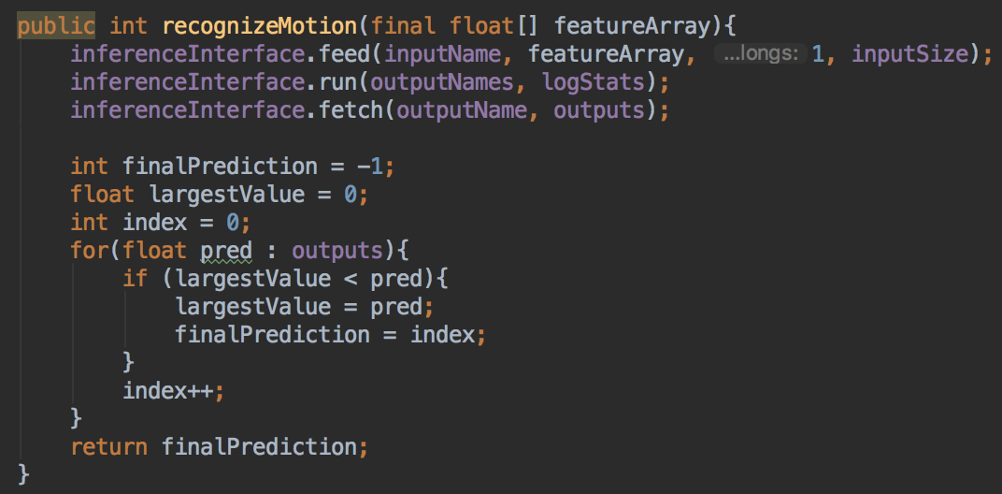
Android App development - Backend - class MotionClassifier

Slide 16
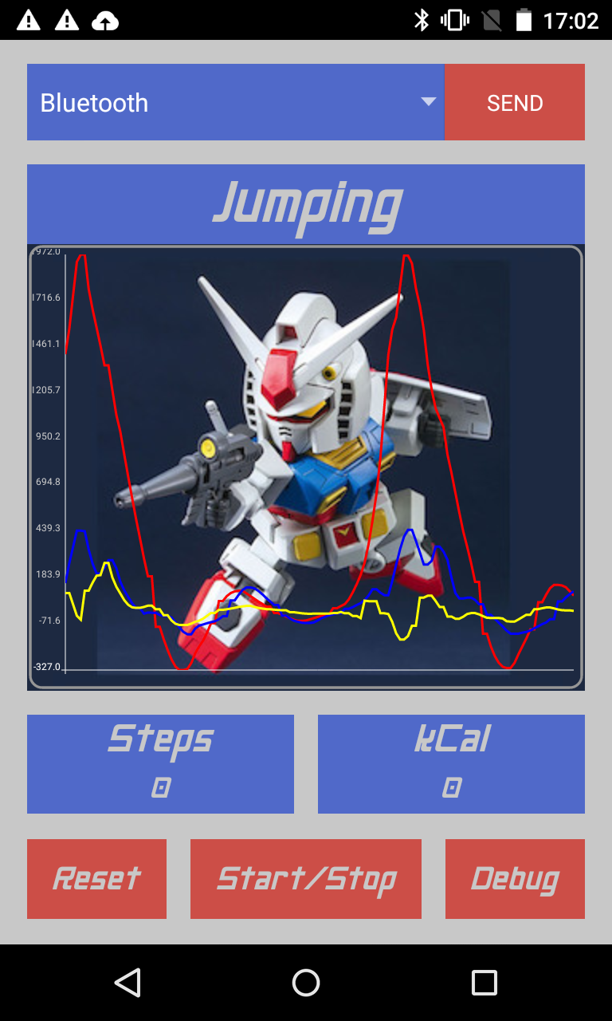
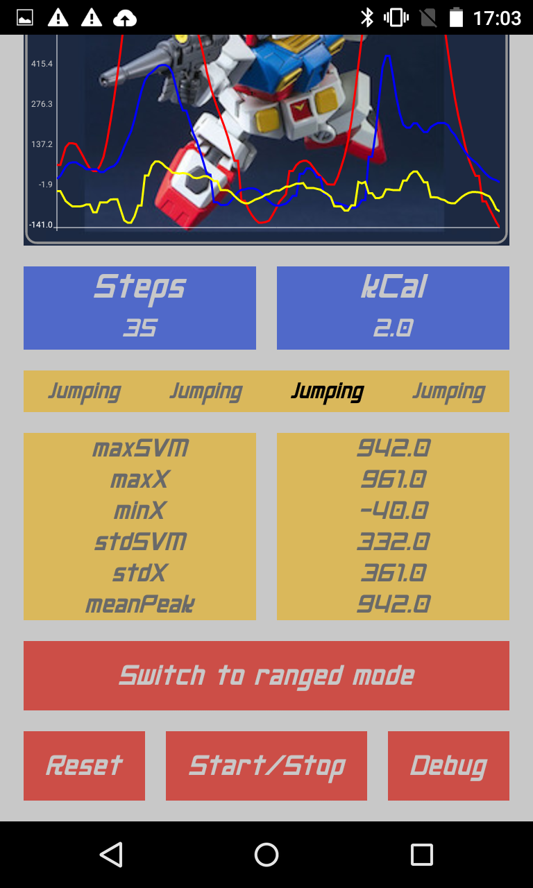
Android App development - GUI
Material Theme
Font: Neo Gen (Gundam style)
Colors: RX-78 grey, RX-78 red, RX-78 yellow
Debug mode: - Last 4 motion states - Most valuable features (contains 78% of the variance in the entire data) - Step counting mode switch
Notes:
-

Slide 17
Android App development - GUI
Involved Widgets: - Button - Horizontal / Vertical layout - Relative layout and much more… :)

Slide 18
Additional features – Step counting
Fundamental idea: - Find local maxima (peaks) in data sequence - Use SVM instead of triaxial data
Tunable parameters: - Minimum distance between peaks - Minimum peak height - Level of Gaussian smoothing - Length of the data sequence
Notes:
Single vector magnitute
So we also implemented the step conting
The main idea of step counting is fing the local maxima, as you can see here, the peaks for each data sequence,
We count the peak and a peak as considered as count of a step
So we use the SVM which is the Single vector magnitude
So the main parameter that is important for the step conting is are….
The most important that we should cinsider is the lenght of the data sequence

Slide 19
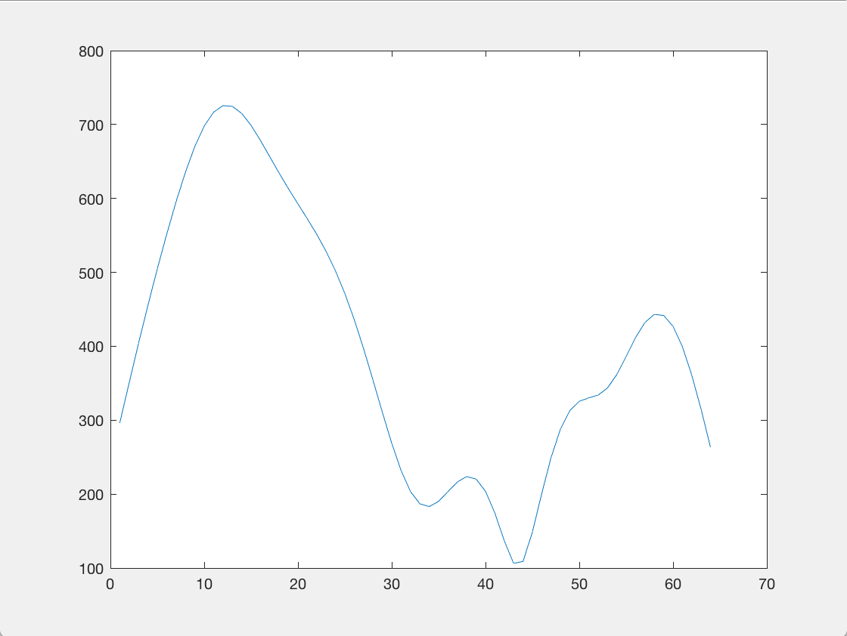
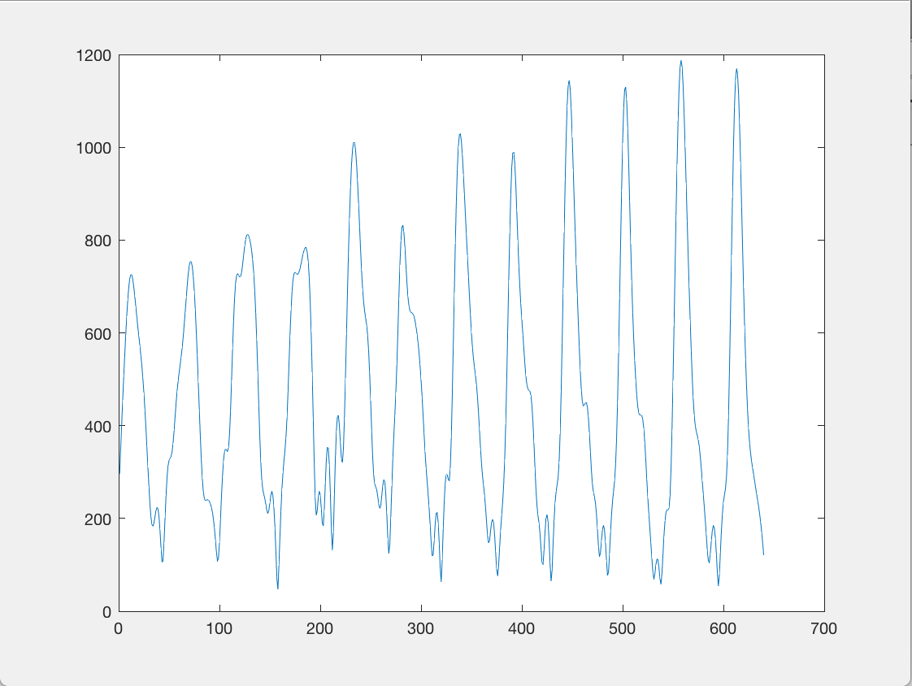
Additional features – Step counting
Length of the data sequence
128 data points (=0.8s) 1280 data points (=8s)
Invalid peak
Notes:
So here is a example of different step conting
Left side is a data sequency of for exmpla 0.8s., which has 128 data ponts
On the left side is a data sequence of 8 s
Possible that this can detec
Dynamic threshold the minimum peak hight depend on the highes peak
If this is in a 0.8 s sequence, there may be 2 peaks detected
So if there is a long data sequence the invalid preak is much smaller than other peak and the detection is more precise

Slide 20
Additional features – Step counting
Length of the data sequence
128 data points (=0.8s) 1280 data points (=8s)
Two peaks instead of one
Notes:
- And also if we look at tihs picture
- If the two data sequence is loated like this, the each of the data sequence will detect the peak , which causes a unaccuacy

Slide 21
Additional features – Step counting
Solution: two different counting modes - Real-Time mode (consider the current 0.8s window of sensor data) - Start-Stop mode (Buffer the data until stop, then consider the whole window)
Notes:
So the solution of this is we implenmented two different counting modes
The real time mode and the start stop mode
The real time mode is the real comsidered the surrent 0.8 window of the sensor data
And the start stop mode- if we switch to the start stop mode it consider the whole window that from start to stop will be
And the whole window of this data will be considered

Slide 22
Additional features – State stabilisation
Error correction based on the latest 4 activities
Example: - „Jump“ „Jump“ „Walk“ „Jump“ - The „Walk“ state could be a potential error - Our model will correct it
The activity displayed on top of the App is the previous state
Notes:
We also have a state stability
The correction is based on the currnet latest 4 activities
For examample if… the walk state could be a potential error
If we just thinkk of the reality, the activity that we do last at least 2 to three second
So the activity displayed on the top of the app is the previous state

Slide 23
Conclusion – Pros and Cons
Pros: - NN Classifier has a very high prediction accuracy - The model is trained offline on PC → Low performance cost on mobile phone - Easy to expand detected activity types - Relatively robust against noise
Cons: - High demand on data collection - The model cannot distinguish sitting from standing - If activity transition occurs within the same window → Model gets confused
Notes:
The training data contains noise, collected data are from different people, so it is very nosiy, but good prediction, app
Traning large nuron data,, high nonlinearity, need a lot of training model
Position of the sensor chest posistion
Angel end position must be the same
Jumping running within 0.8 second

Slide 24
Conclusion – Future work
Better GUI
Try other sensor wearing positions (e.g. inside a pocket etc.)

Slide 25
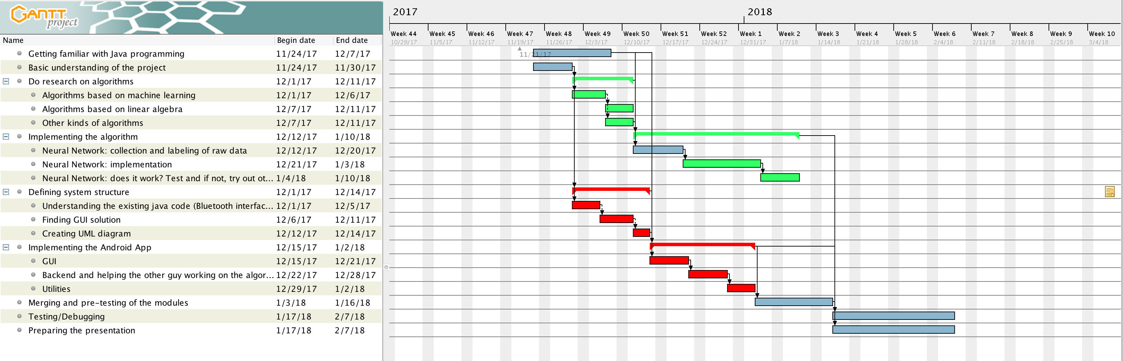
Conclusion – Project schedule
Notes:
Accoring to the gantt chart, basically we stick to the chart
But at the beginning of december: f implementing the algorithm, we delayed for two week
But powerede up in the chrismas break
And finished early than we think
So the gannt chart really helped us to stick on the timeline and we can always refer and know oir procedure

Slide 26
Thank You

Slide 27
Your Contact Person
Beike Lu
Project Manager
lubeike93@gmail.com
Mobil: 0162/1032097

